Slide 1

Topic : Un-Supervised Learning
Cluster Analysis
Dr N V Ganapathi Raju

Slide 2
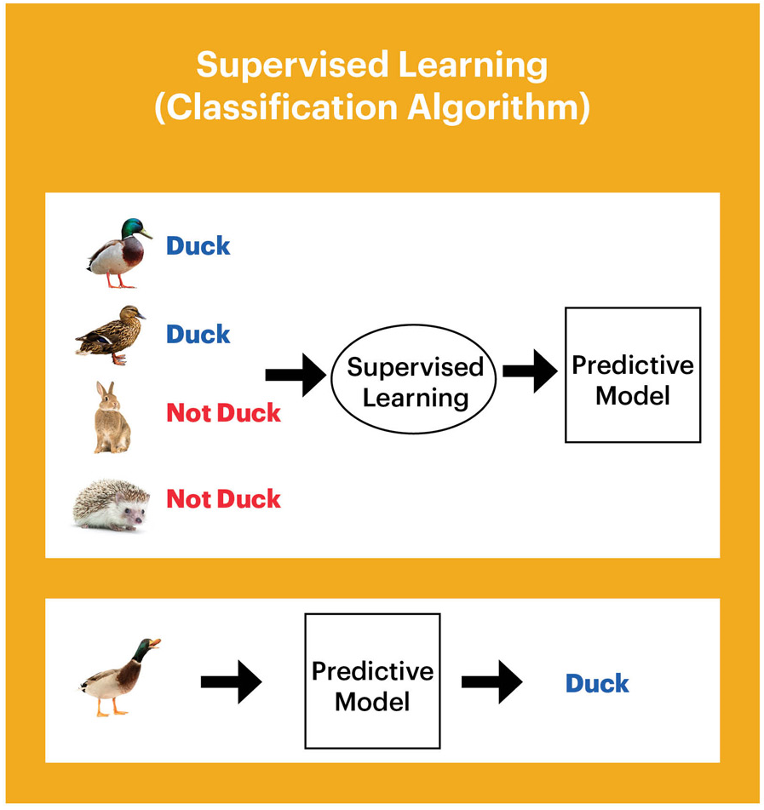
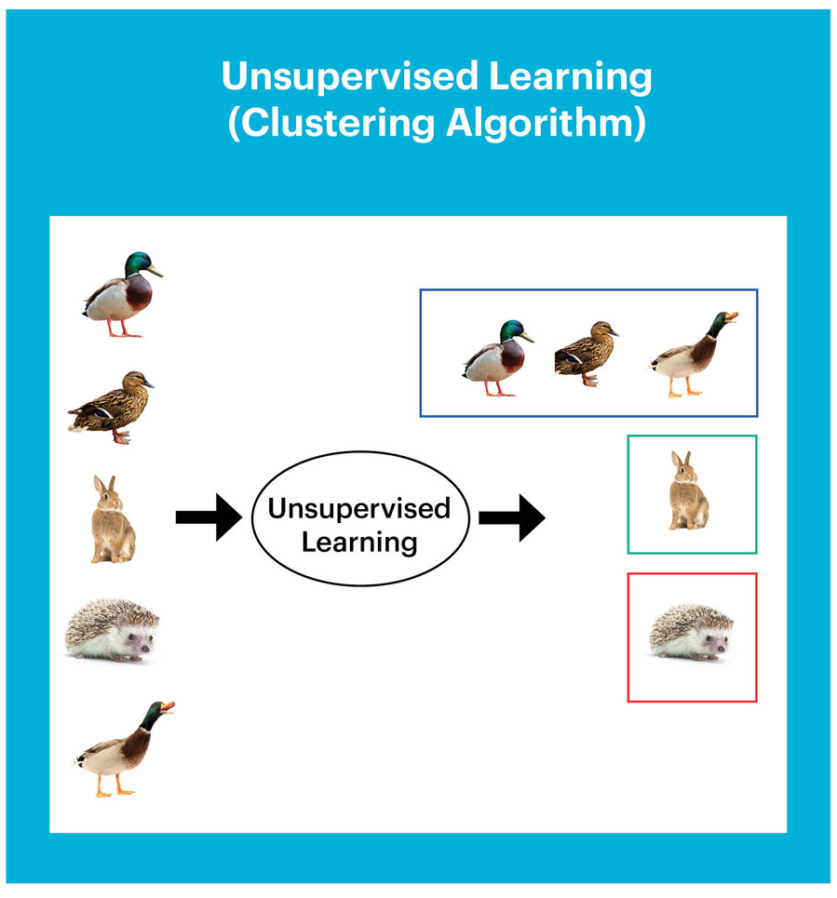
Machine Learning
Allows computers to learn and
infer from data
Types of Machine Learning
Supervised
Unsupervised
Reinforcement Learning
Supervised Learning
Data points have a known outcome
Unsupervised Learning
Data points have unknown outcome

Slide 3
Machine Learning
supervised Learning
unsupervised learning
reinforcement learning
classification
regression
clustering
Q-learning
Markov Decision Process
decision trees
linear
non-linear
K-means
KNN
K-modes
* linear
regression
ANN
Naïve Bayes
K-medoids
SVM
SVM
DBscan
Ridge, Lasso
* logistic regression
agglomerative
divisive
* multinomial logistic regression
Convolutional Neural Network
* Artificial Neural Network
Deep Learning
Recurrent Neural Network

Slide 4
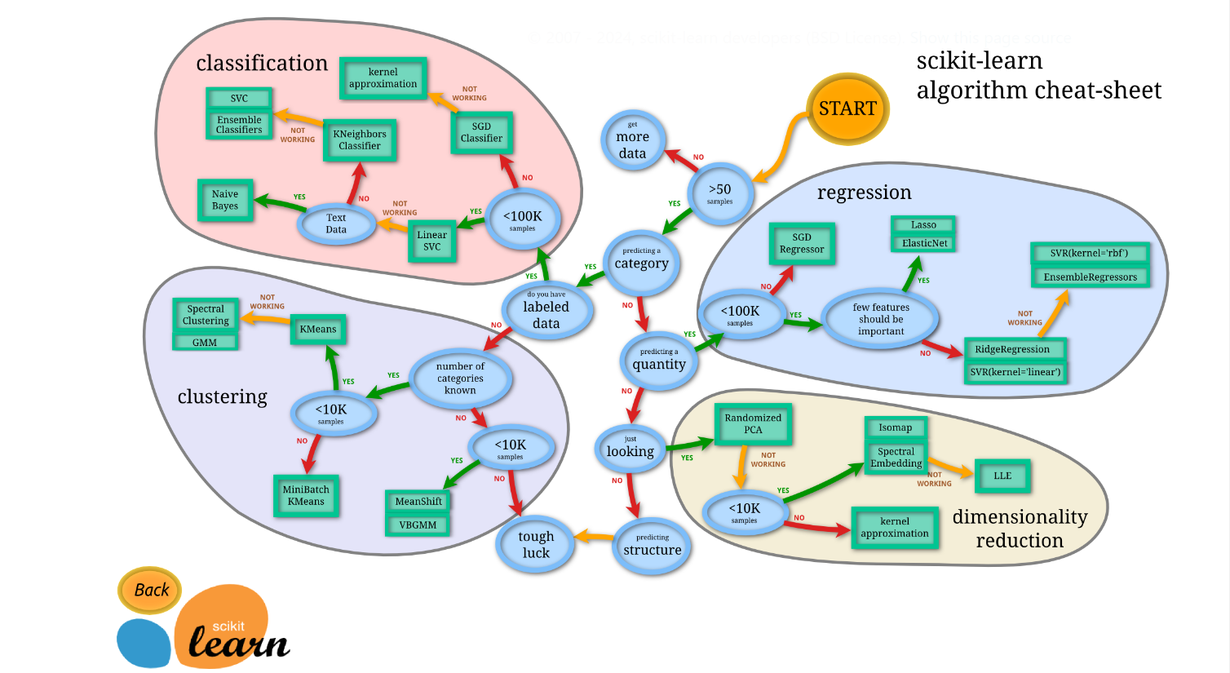


Slide 5
Cluster Analysis
Cluster: A collection of data objects
similar (or related) to one another within the same group
dissimilar (or unrelated) to the objects in other groups
Cluster analysis (or clustering, data segmentation, …)
Finding similarities between data according to the characteristics found in the data and grouping similar data objects into clusters
Unsupervised learning: no predefined classes (i.e., learning by observations vs. learning by examples: supervised

Slide 6
Quality: What Is Good Clustering
A good clustering method will produce high quality clusters
high intra-class similarity: cohesive within clusters
low inter-class similarity: distinctive between clusters
The quality of a clustering method depends on
the similarity measure used by the method
its implementation, and
Its ability to discover some or all of the hidden patterns

Slide 7
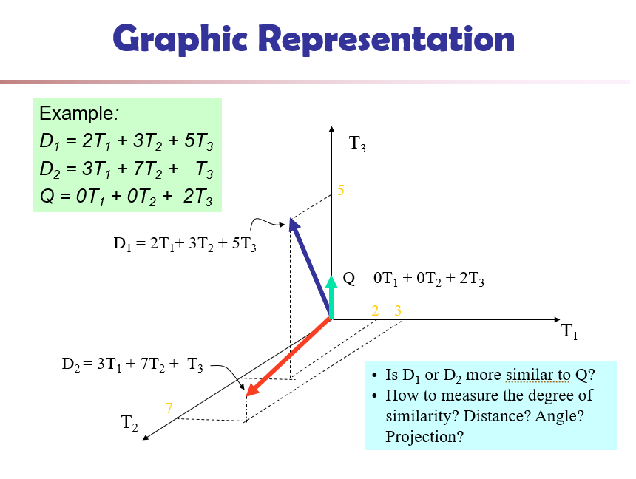

Slide 8
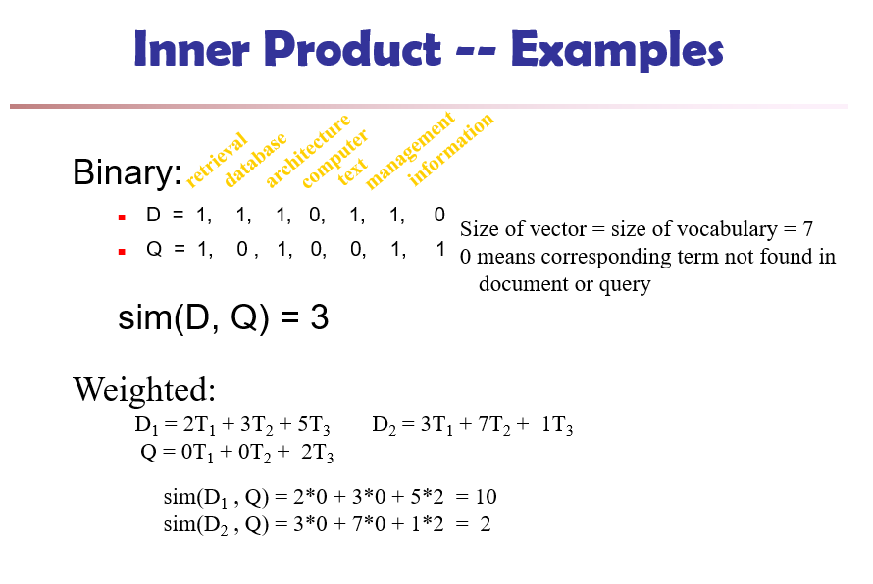

Slide 9
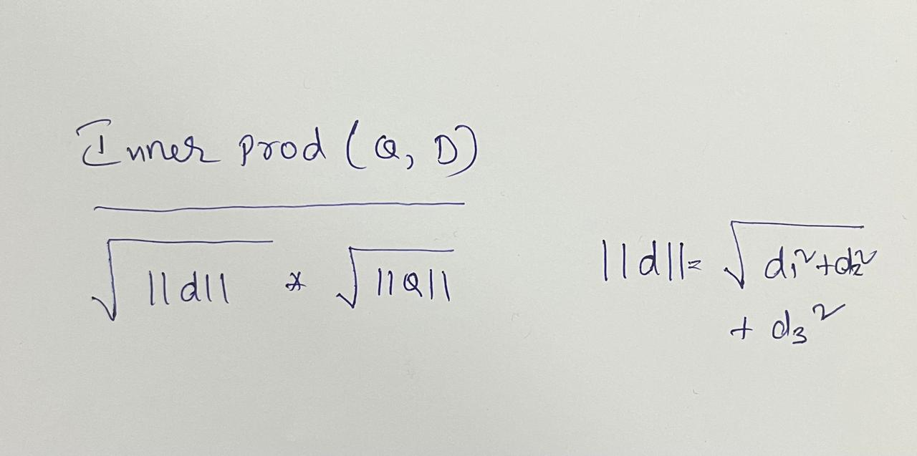
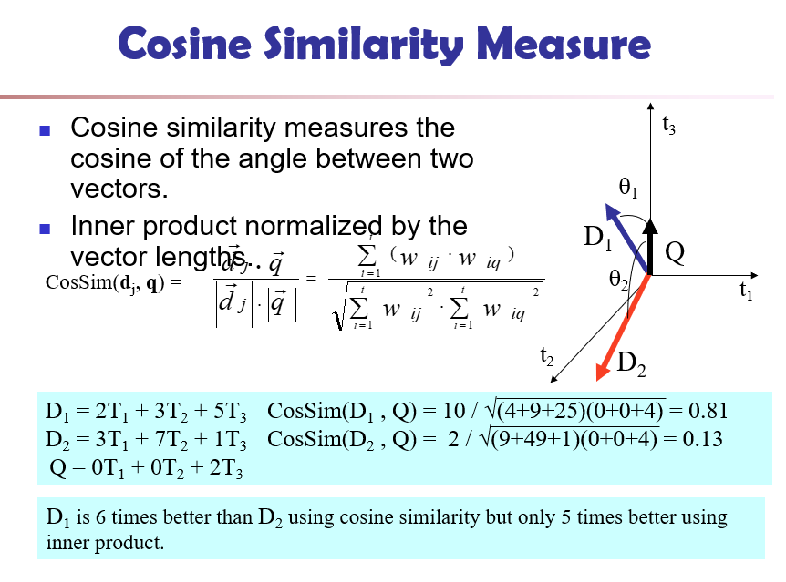

Slide 10
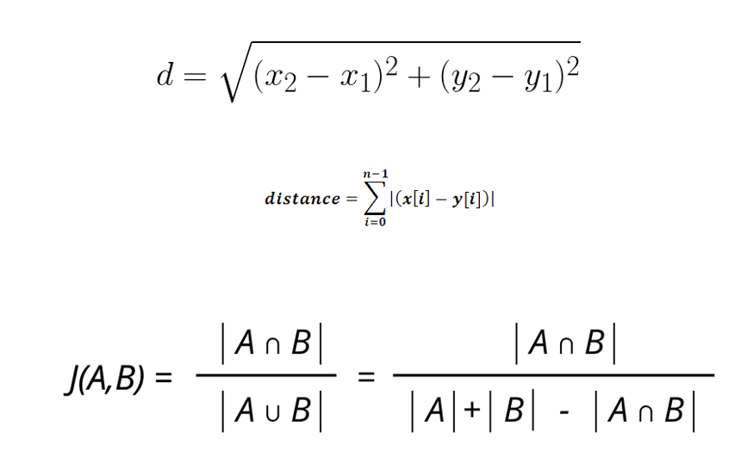

Slide 11
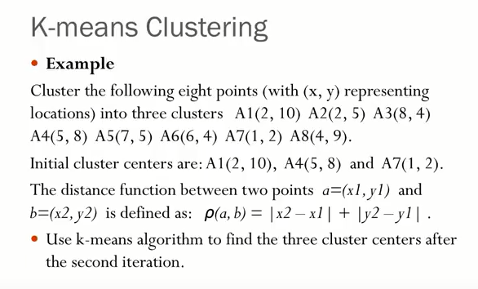

Slide 12
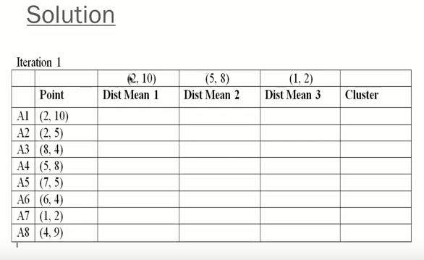

Slide 13
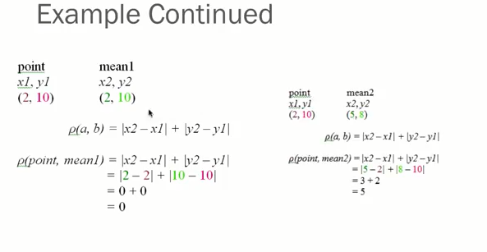

Slide 14
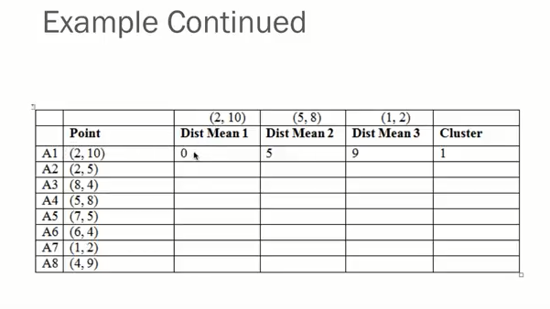

Slide 15
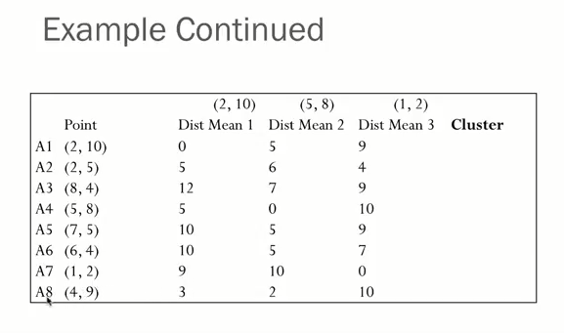

Slide 16
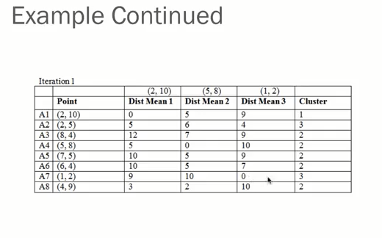
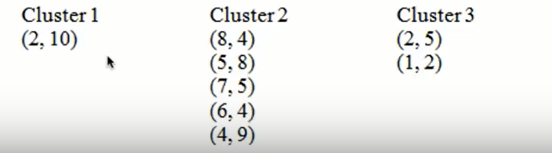

Slide 17
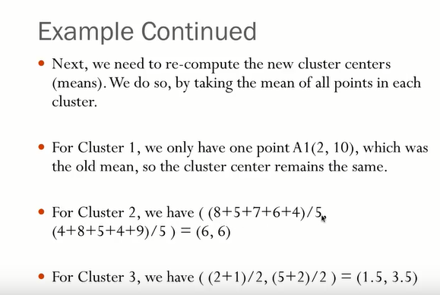

Slide 18
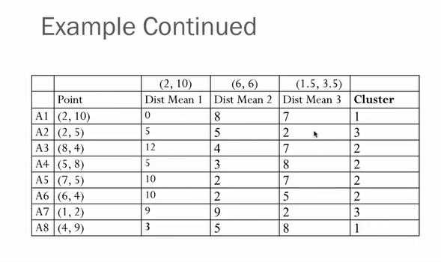

Slide 19
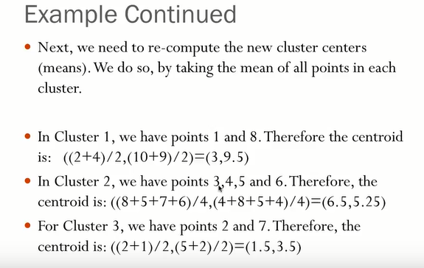

Slide 20
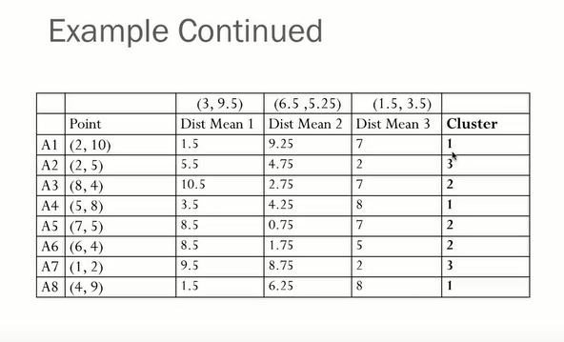

Slide 21
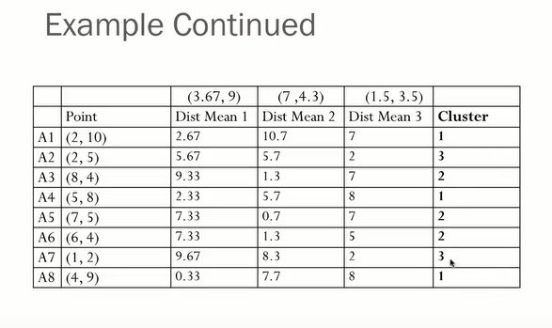

Slide 22
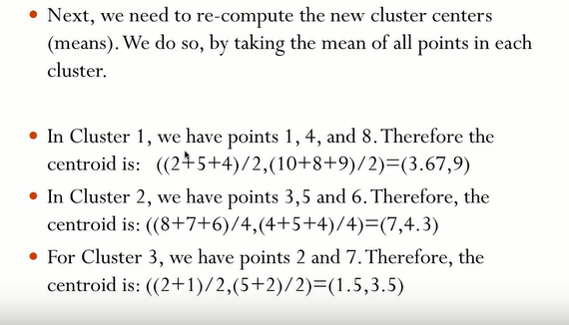

Slide 23
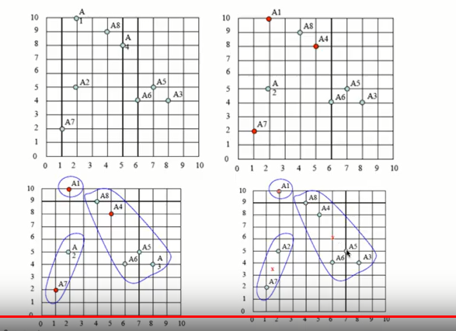

Slide 24
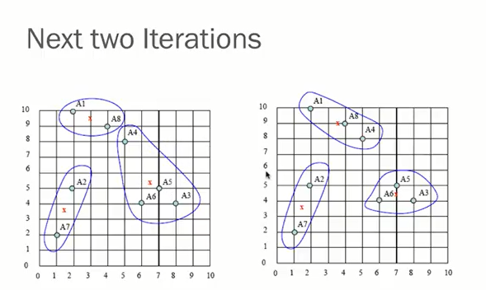
If We want to stop Iteration of K-Means algorithm
: Previous cluster and New Cluster should be same then we will stop.

Slide 25
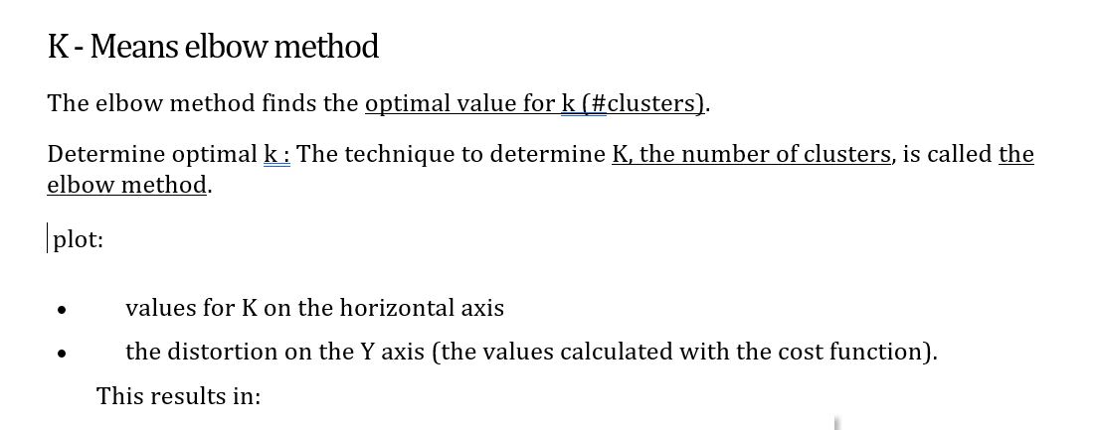
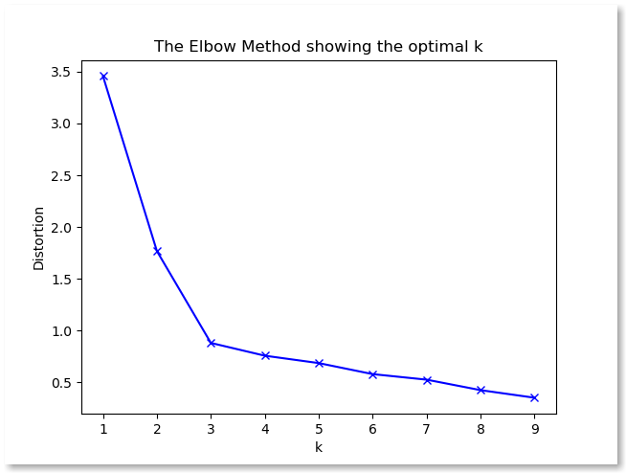

Slide 26
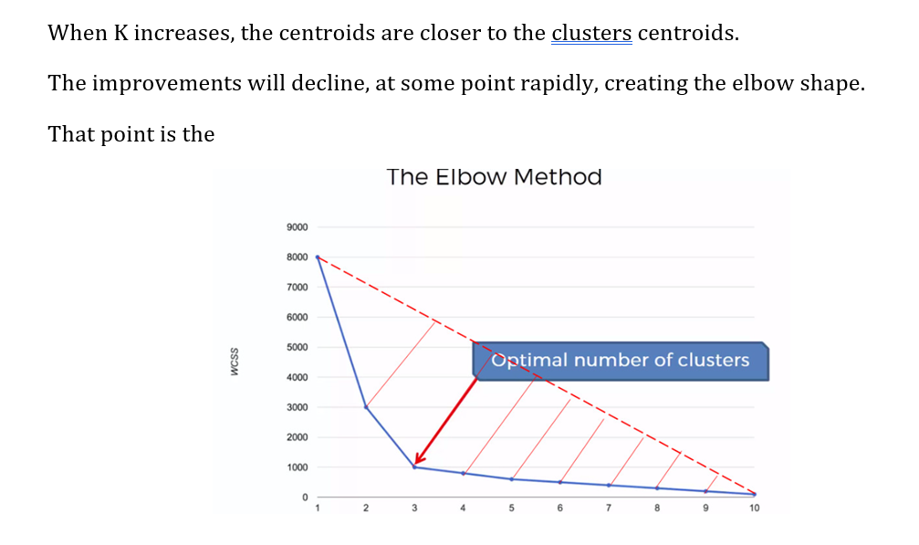

Slide 27
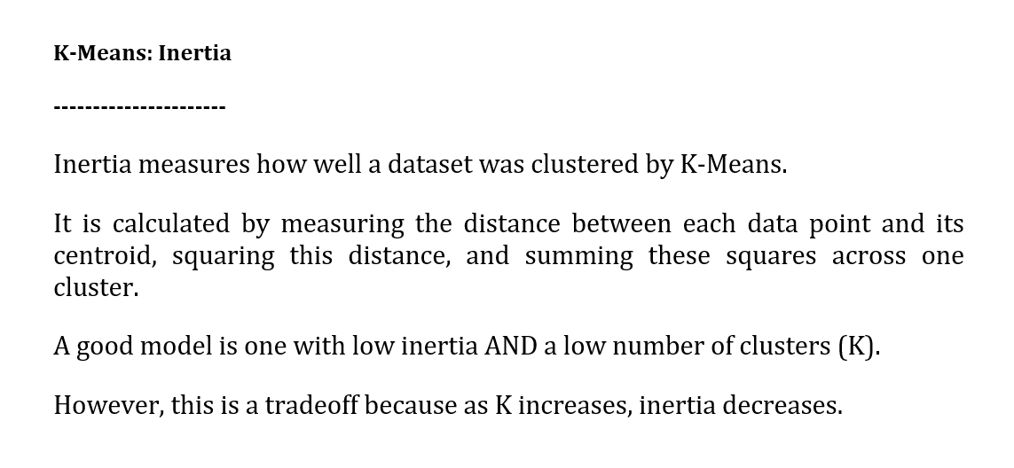

Slide 28
The K-Means Clustering Method
Given k, the k-means algorithm is implemented in four steps:
Partition objects into k nonempty subsets
Compute seed points as the centroids of the clusters of the current partitioning (the centroid is the center, i.e., mean point, of the cluster)
Assign each object to the cluster with the nearest seed point
Go back to Step 2, stop when the assignment does not change

Slide 29
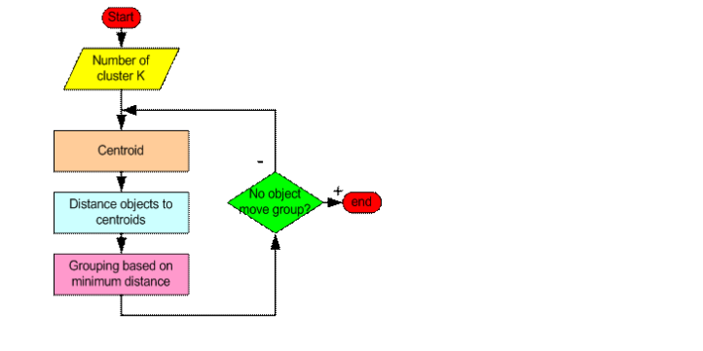
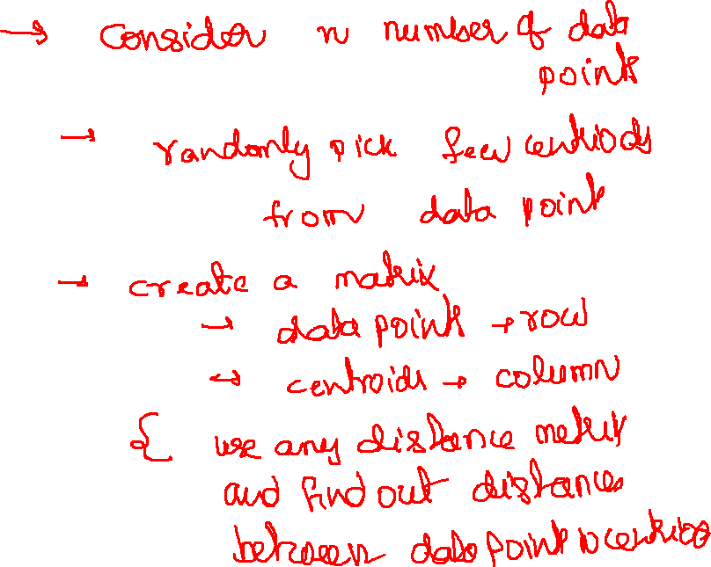

Slide 32
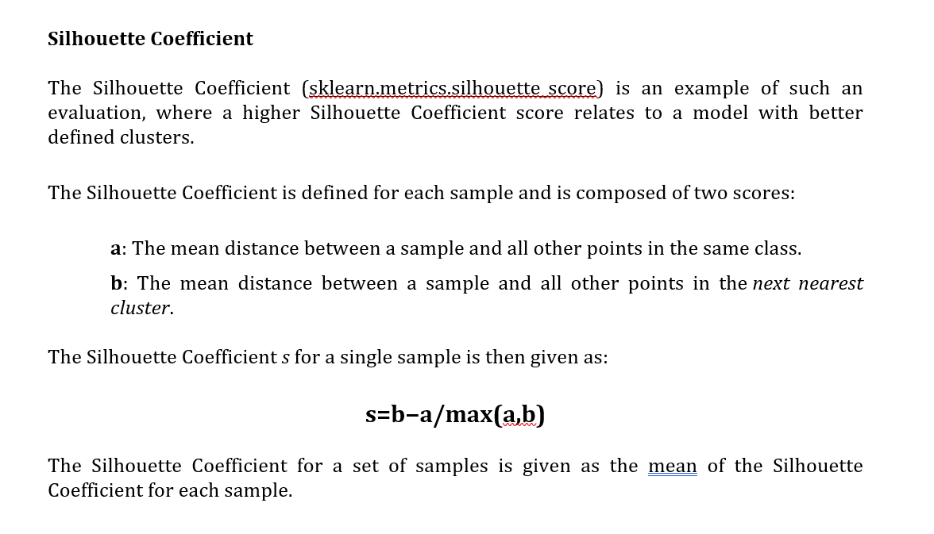

Slide 33
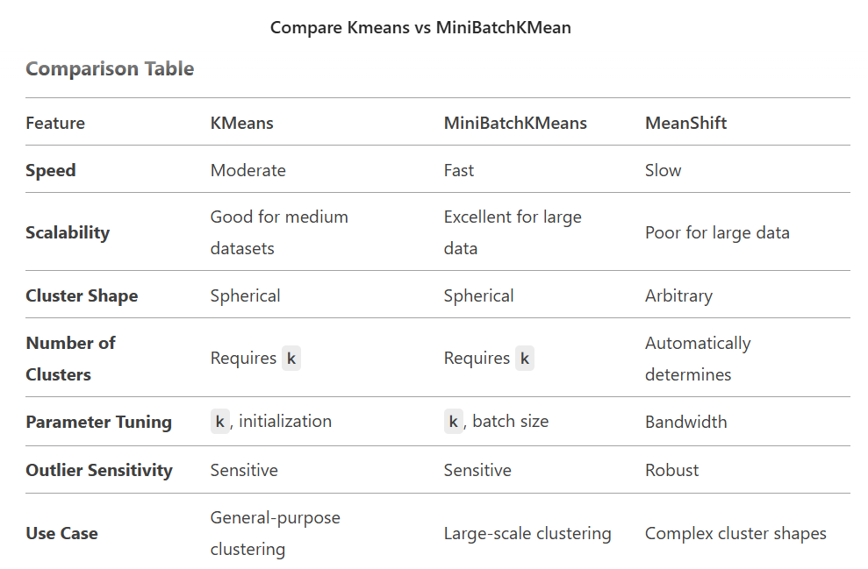
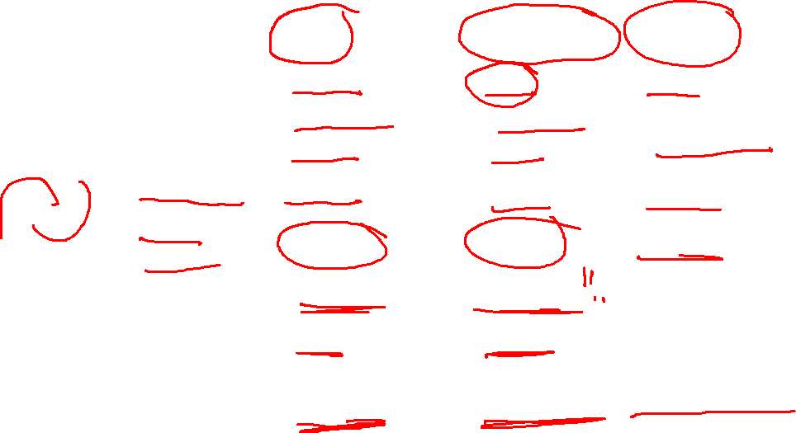

Slide 34
